Slide 1
Citizens’ Senate meeting no 29
22nd Feb 2021
Presenter: Trevor Fernandes
Moderator: Szara Coote

Slide 2
Agenda
11.00 Intro / Housekeeping
11.10 Personalised Care
12.00 Break
12.15 Sharing Experience - Sarah Rae
12.40 Sharing Experience - Colin Stodel
13.00 Involvement Opportunities
13.15 Citizens’ Senate sustainability options
13.30 Close

Slide 3
Agenda
Personalised Care
30% of population with long term physical and mental health Conditions
5% of population have complex needs
70% of each health pound supports people with LTC
50% of GP appointments are made by people with LTCs
70% of hospital beds for people with LTC
200,000 people receiving personalized care
2.5m people by 2024 to receive personalized care
Complex needs
Long term physical & mental health conditions
Receiving NHS CHC

Slide 4
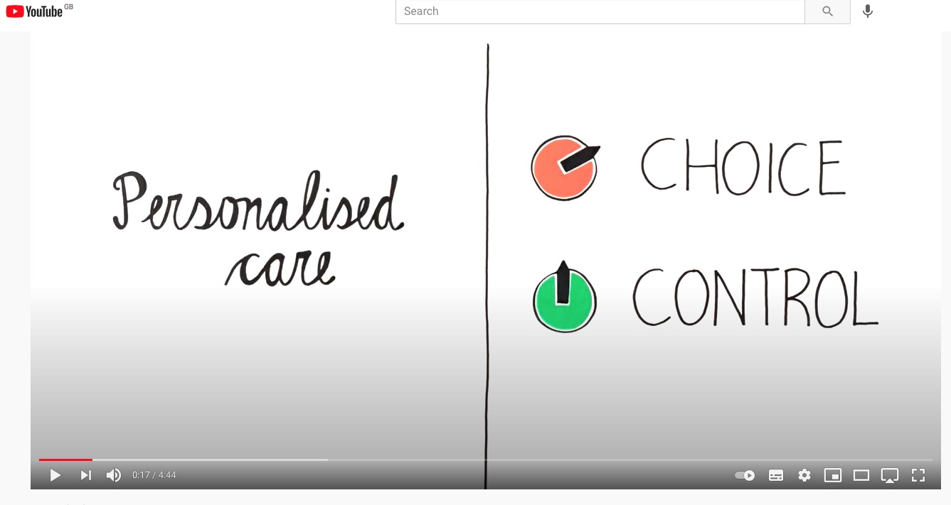
Agenda
Personalised Care
Personalised Care Model - https://youtu.be/RXOd-7rn6so NHS Continuing Healthcare - https://youtu.be/9xE2oGVRqvY

Slide 5
Agenda
What is Personalised Care?
Personalised care means people have choice and control over the way their care is planned and delivered
Personalised Care and Support Planning enables people to join in conversations about their health and well-being and shape their care and support.
Shared Decision Making clinicians support people to make decisions about their treatment and care
Choice in the NHS services they use
Social Prescribing link workers connect people to community groups and statutory services for practical and emotional support.
5. Supported Self-Management helps people to manage their own health and care by building up their knowledge, skills and confidence.
6. Personal Health Budgets, an amount of money to meet their health and well-being needs, planned and agreed between them and their NHS team.
Personalised Care Model - https://youtu.be/RXOd-7rn6so
NHS Continuing Healthcare - https://youtu.be/9xE2oGVRqvY

Slide 6
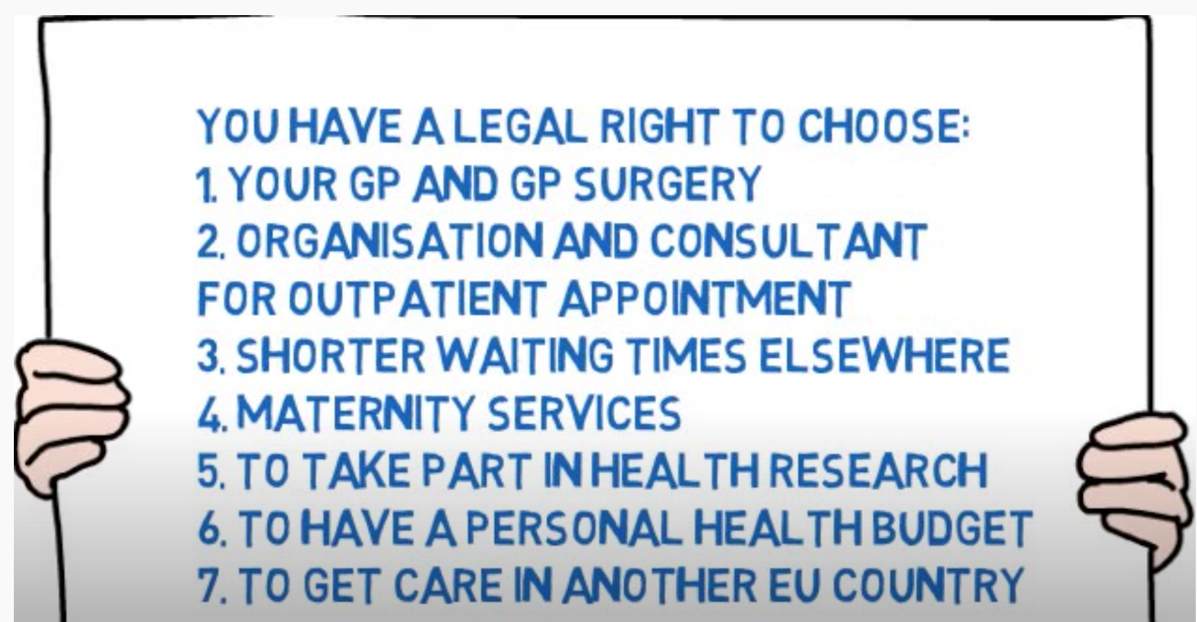
Agenda
Personalised Care – your rights
Personalised Care Model - https://youtu.be/RXOd-7rn6so NHS Continuing Healthcare - https://youtu.be/9xE2oGVRqvY

Slide 7
Agenda
What does Personalised Care mean for us?
A shift in relationship between health & care professionals and people
from being seen as a patient with symptoms or separate conditions that needs treating
to being seen as a whole person with strengths and attributes as well as needs to be met.
Personalised care means that services and support should be tailored to
the needs of every individual, rather than delivered in a one-size-fits-all
fashion.
Shifts to
from being asked
‘what’s the matter with you’?
Shifts to
to being asked ‘what matters to you?
from having to tell your story again and again
Shifts to
to only needing to tell your story once.
Feeling powerless against complex healthcare system
Shifts to
Working in partnership and sharing power

Slide 8
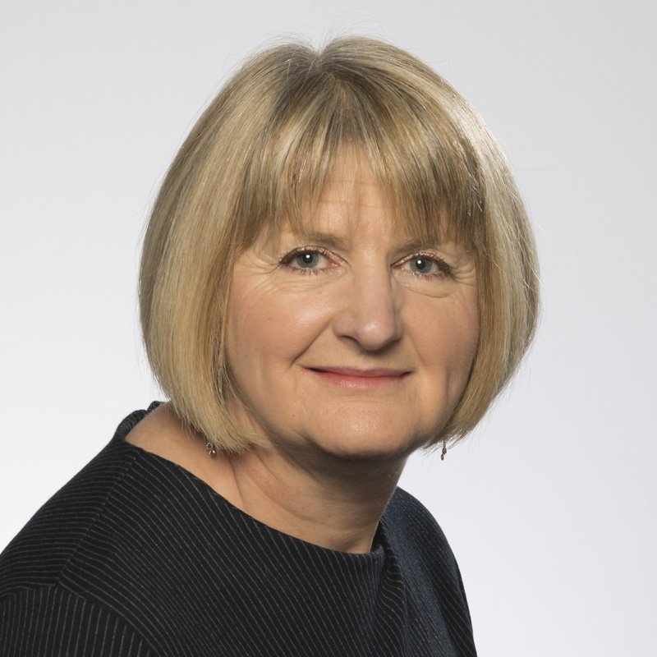
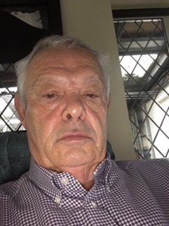
Agenda
Sharing your experience
Sarah will describe her journey of co leading a multi professional team to apply for research funding. She will share her experience of the challenges and pitfalls in achieving shortlisting status.
Hopefully, this will inspire others to see what is possible and what can be achieved
Colin is Patient & Public Voice for his CCG in Herts. He will share his experience and observation of working with CCGs in the light of the pandemic. Colin will talk about the challenges and solutions, so that we can be aware of similar issues in our localities
Sarah Rae
Colin Stodel

Slide 9
Agenda
Eastern Involvement work
Mental Health Programme - Nick Clarke. This is a national priority for all AHSNs. Commencing with ADHD & Obesity. Interest - K James, V Carr, S Rae
Genomic Hub Alliance - Richard Sandford Interest - S Rae, C Stodel, J Dearling, P Osman
CVD Prevention Programme - Ben Jackson A National priority for AF, FH, LM & Hypertension Interest - C Stodel, P Ruddy
Learning Disability and Autism Programme (LeDeR). Responded to bid – In progress Trevor, Helen
Innovation Hub. Responded to bid - £475k In progress Helen, Trevor
Brain Injury Research - NIHR Brain Injury MedTech Cooperative. PPI research involvement
Cambridge Children's Network - Young people and families’ views needed to build new children’s hospital on Addenbrookes site

Slide 10
Agenda
Eastern Involvement work
Task Force for Multiple Conditions - Richmond Group. The overarching aim of the Taskforce is for people with multiple long-term health problems to live as well as possible for as long as possible.
Neurocognitive mechanisms underlying dissociative amnesia - It would be particularly useful if reviewers had lived experience of depression and/or memory difficulties (amnesia).
CPFT Research Database Oversight Committee - Expert by Experience (EbE) to join the CPFT Research Database Oversight Committee
NHSE Clinical Reference Group PPV Partner

