Slide 1
Citizens’ Senate meeting no 32
24th August 2021
Presenter: Trevor Fernandes
Moderator: Szara Coote

Slide 2
Our purpose / aims
Involvement in programmes, services, policy & research
Access to specialist Health Professionals and speakers
Information and guidance on NHS policy and service change
Support innovation for patient benefit

Slide 3
Agenda
11.00 - Welcome & intro.
11.05 - PPI Masterclass - Lindsey Cook, Citizens’ Senate member & Non Exec Director EAHSN
11.15 - Welcome to Sandeep Chauhan, Founder Definition Health and NIA Fellow.
11.45 - Break (5 mins)
11.50 - Citizens’ Senate Survey – we want to share the outcome and share the learning and themes
12.15 - Sharing experience
12.25 - The Big Collaboration Event – Leading for Care Integration
Notes:
Definition Health is a digital pre and post-op communications tool between hospital and patient, providing the first end to end journey for surgical patients.

Slide 4
PPI Masterclass
Insight to Impact Masterclass- Patient Participation and Co-Design
Lindsey Cook, Citizens’ Senate member & Non Exec Director EAHSN
27th January 2022

Slide 5
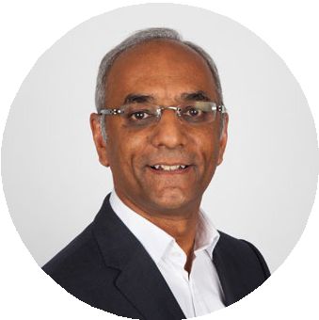
Definition Health
Definition Health
Sandeep Chauhan
A digital pre- and post-op communications tool between hospital and patient, providing the first end to end journey for surgical patients in the UK.
Notes:
As usual, we are asking you to raise awareness and share widely with your networks and spheres of influence, particularly those of you involved in Trust Patient Councils
Definition Health was recently awarded an Innovate UK grant for its digital dialogue project on patient recovery.
Sandeep’s goal in co-founding Definition Health was to place patients in the centre of a complete digital surgical journey in the UK. Deployed in 10 UK hospitals with 50,000 patients registered, it has improved patient experience and education, whilst reducing cost for hospitals.

Slide 6
CS Member Survey
Citizens’ Senate member 2021 survey
Notes:
Citizen' Senate Membership and Commitment Survey 23 Responses
Majority preferences
Frequency - 8 weekly
Duration 1.5hrs
Content - more focus on MH and social care and Member’s feedback interesting
Face to face
Clear objectives
Keeping details updated
Keeping details of involvement updated
Happy to participate in surveys about health
Happy to use lived experience in PPI work

Slide 7
Q3 Are you happy with agenda / content
More about MH in ED, incl frequent Flyers
Focus on specific conditions
More about changes in primary care
More opportunity to share and compare, also to recommend research proj
Fewer speakers, more time for questions
Making suggestions, TF does not always concur
All Cs meetings interesting and thought provoking
Happy with agenda & content
Any new members, need to arrange another NIHR PI Collaborative presentation
Anything that improves patient focus & outcomes
More about role and function of medicines
Not sure about purpose. Should spend time working together and making decisions

Slide 8
CS Member Survey
Citizens’ Senate member 2021 survey
Notes:
Citizen' Senate Membership and Commitment Survey 23 Responses
Majority preferences
Frequency - 8 weekly
Duration 1.5hrs
Content - more focus on MH and social care and Member’s feedback interesting
Face to face
Clear objectives
Keeping details updated
Keeping details of involvement updated
Happy to participate in surveys about health
Happy to use lived experience in PPI work

Slide 9
CS Member Survey
Citizens’ Senate member 2021 survey
Notes:
Citizen' Senate Membership and Commitment Survey 23 Responses
Majority preferences
Frequency - 8 weekly
Duration 1.5hrs
Content - more focus on MH and social care and Member’s feedback interesting
Face to face
Clear objectives
Keeping details updated
Keeping details of involvement updated
Happy to participate in surveys about health
Happy to use lived experience in PPI work

Slide 10
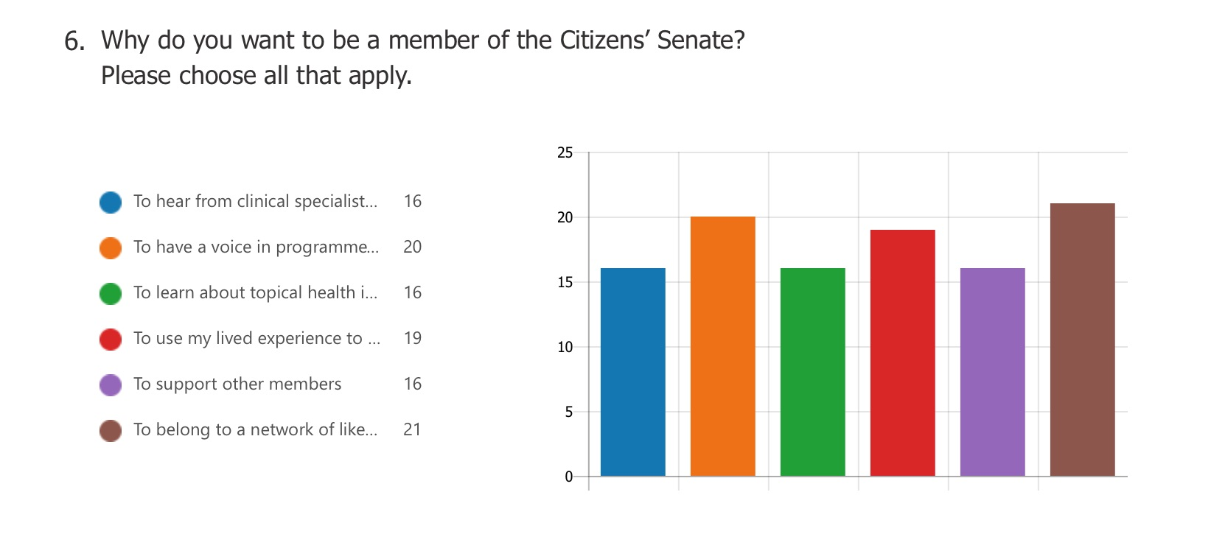
CS Member Survey
Citizens’ Senate member 2021 survey

Slide 11
CS Member Survey
Citizens’ Senate member 2021 survey
Notes:
Citizen' Senate Membership and Commitment Survey 23 Responses
Majority preferences
Frequency - 8 weekly
Duration 1.5hrs
Content - more focus on MH and social care and Member’s feedback interesting
Face to face
Clear objectives
Keeping details updated
Keeping details of involvement updated
Happy to participate in surveys about health
Happy to use lived experience in PPI work

Slide 12
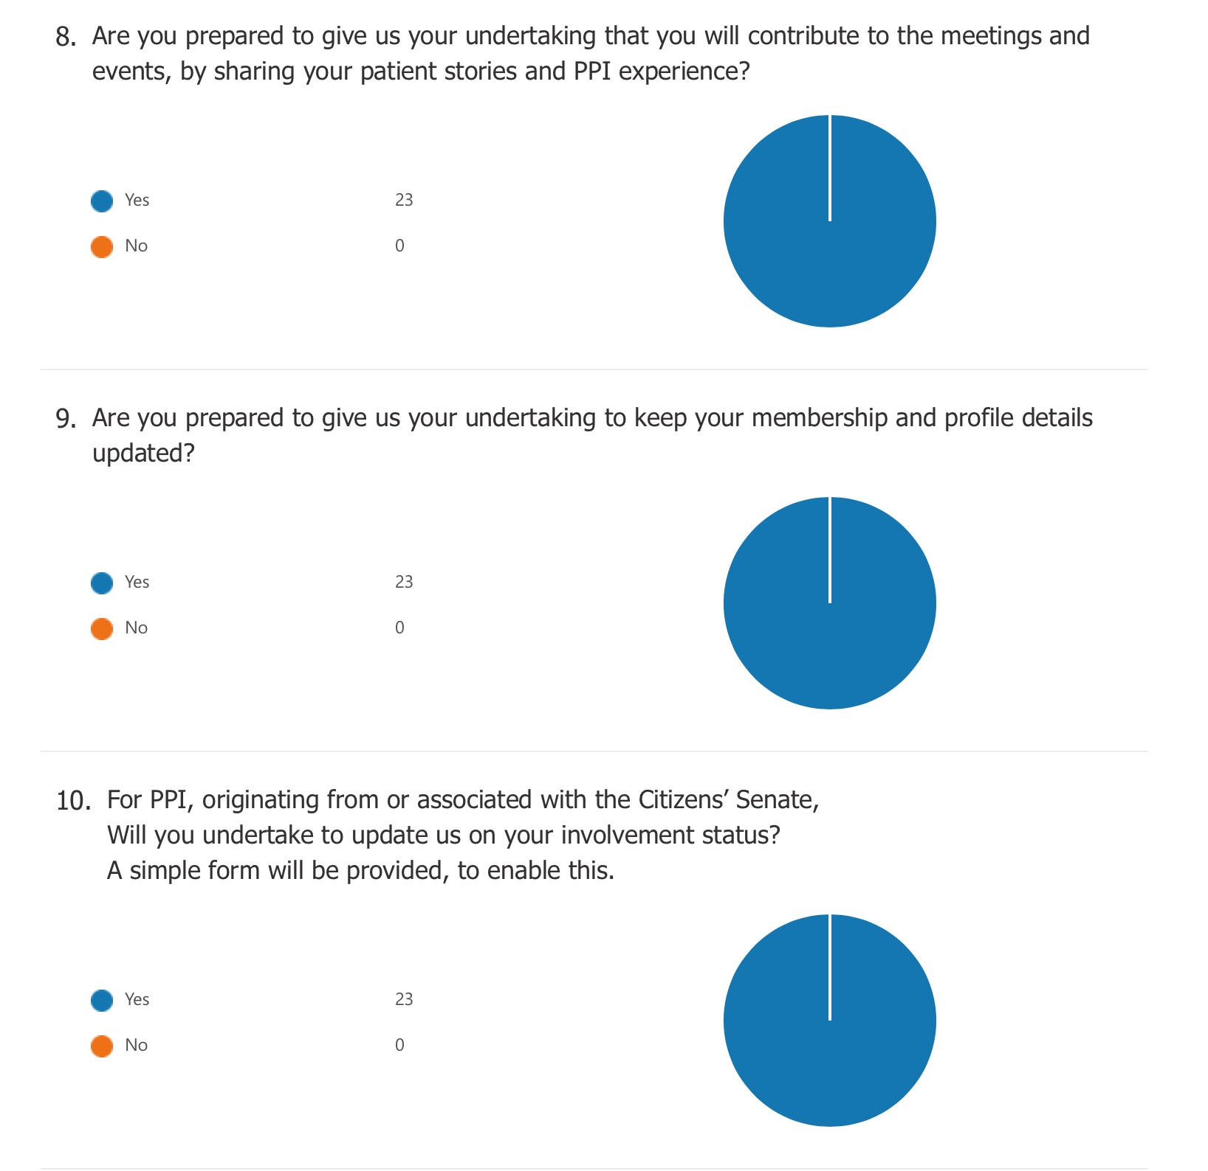
CS Member Survey
Notes:
Citizen' Senate Membership and Commitment Survey 23 Responses
Majority preferences
Frequency - 8 weekly
Duration 1.5hrs
Content - more focus on MH and social care and Member’s feedback interesting
Face to face
Clear objectives
Keeping details updated
Keeping details of involvement updated
Happy to participate in surveys about health
Happy to use lived experience in PPI work

Slide 13
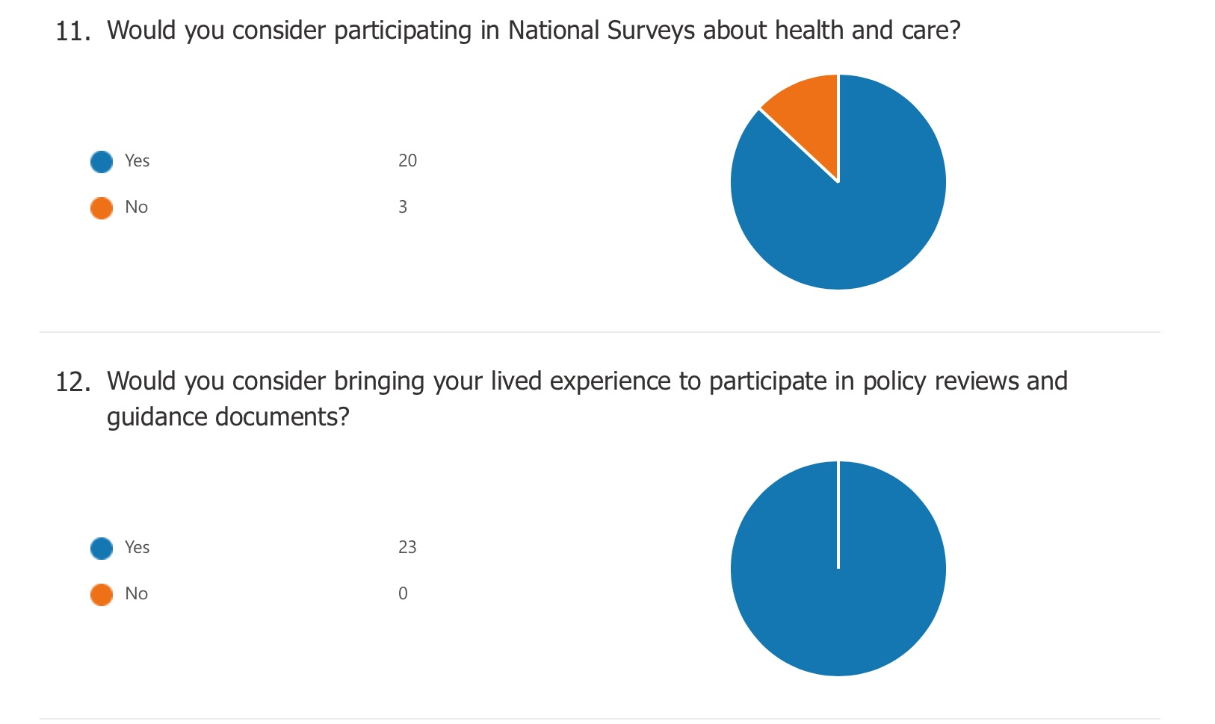
CS Member Survey
Notes:
Citizen' Senate Membership and Commitment Survey 23 Responses
Majority preferences
Frequency - 8 weekly
Duration 1.5hrs
Content - more focus on MH and social care and Member’s feedback interesting
Face to face
Clear objectives
Keeping details updated
Keeping details of involvement updated
Happy to participate in surveys about health
Happy to use lived experience in PPI work

Slide 14
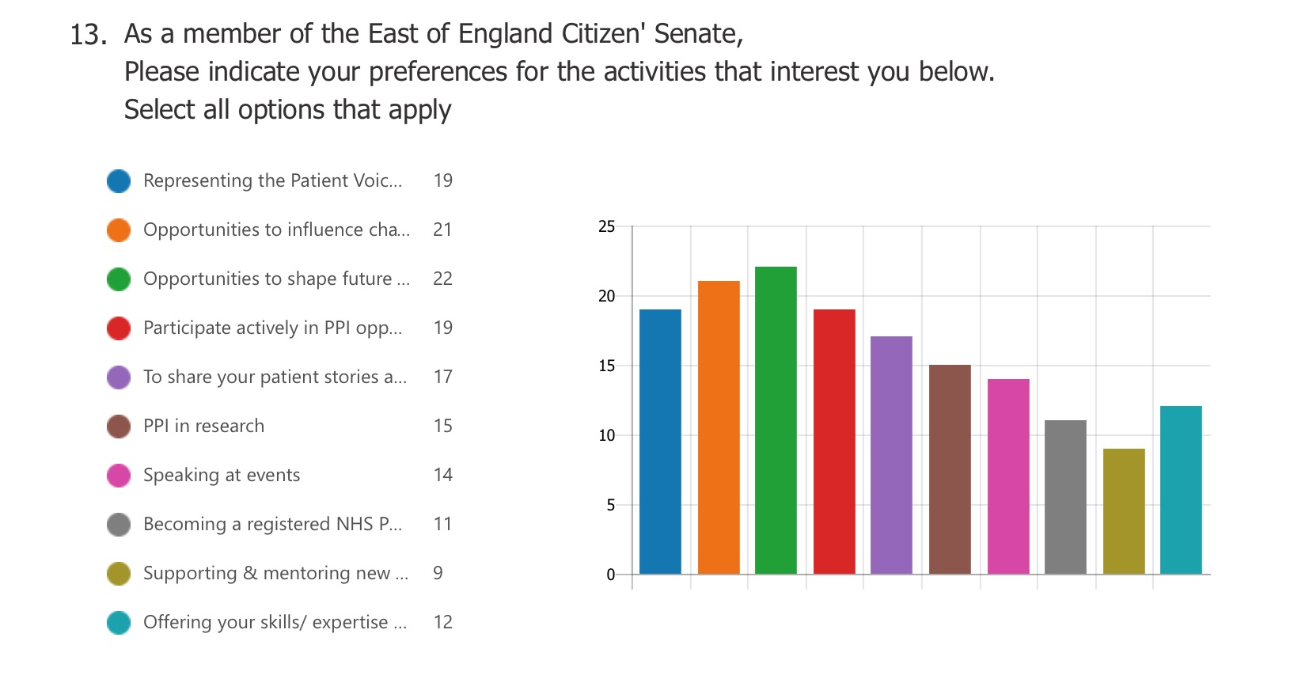
CS Member Survey

Slide 15
Any other info about this survey
CS Member Survey
Membership recruitment is a foremost requirement of both existing and new recruits. We should appoint a membership officer and perhaps a PR spokesman. Please please don’t be pressurised by external organisations timescales. It seems that we are the victims of others inefficiencies
As I already am heavily involved in patient participation for east herts CCG /PCN and we are already well underway towards transitioning into an ICS it is quite difficult to know how to add value to the citizens senate at this stage
We need to think about how we can increase the effectiveness of PPI across the East of England. PPV Expert Advisor for Palliative and End of Life Clinical Senate.
I find that Zoom meetings tend to be more focused, time effective and productive than F2F ones, so while I would go along with F2F meetings if that is the democratic view, Zoom meetings are better for me, not least because part of my disability is a problem with stamina, and driving long distances to meetings challenges my own limitations. The ideal would be arranging hybrid meetings where participants could meet up F2F and online. It would also save a great deal of money.
I can’t wait to resume face-face meetings. I just attended my first surgery PPG and it was great with tremendous synergy generated. Although it was not listed as an option, I much prefer the all day meetings we used to have at Cambridge.

Slide 16
Q14. Any other info about this survey and any involvement activities via the CS
CS Member Survey
Started Peer Leadership Development Programme run by Future Learn online course, have Certificate of Achievement Personalised Care: Peer Leadership Foundation- Step One (of 4). James Paget University Hospital User Group chaired by Amanda Hood Patient Experience Head of Dept. wants to have a patient user to chair the meetings as she feels she is biased (as paid employee for the hospital) I have volunteered if all the group want me to be chair. Instead of being called User Group I would like to change to call them NHS Co-Producers and to encourage them to do the Peer Leadership Development Programme so they feel equal to any NHS employees and workers can understand the NHS, new procedures, and discuss on equal terms with NHS staff .
Not via the CS but due to being a member of the CS it helped me to see other opportunities, including: NHS England Chemotherapy CRG PPI member / PPI input into bids for Eastern AHSN / Non Exec Director for Eastern AHSN with special interest in PPI / Member of the AHSN Innovation Review Panel
Drug the last 12 months I have become involved in: • The Cancer Alliance Covid Cell via the Cancer Alliance Patient Participation Group • The Cancer Alliance work rolling out Virtual Group Cancer Care Reviews • The project to develop the new Cambridge Cancer Research Hospital (I’m one of two patient members of the Joint Delivery Board)
NHS England & Improvement Mental Health Demand Signalling workshops PPI Member Role in the NIHR National ARC Mental Health and Wellbeing Collaboration NHS England and Improvement East of England Region - interview re: accessing digital primary care

Slide 17
Q14. Any other info about this survey and any involvement activities via the CS
CS Member Survey
I am tempted to train to become a registered NHS Peer Leader but I'm feeling demoralised with the NHS. I do realise that they are incredibly over stretched but my concern is that I will spend time investing learning and training into something that will never really materialise like so many times before and I just don't think I can put myself through it again.
I have so little spare time that it is very hard for me to involved as much as I want to, and to be honest the last 12 months have been quite rough (as I expect it has with an awful lot of people). I just hope that you will keep me onboard. I am happy to be involved with anything around mental health as that is what I know about as a patient and a parent carer and as my job. We have also just started a new project with people living with a SMI who also have physical health needs which I am finding very interesting and also worrying that they are just not getting hardly any support, hence the new project.
I applied for the National PPI but was unsuccessful applied for the peer leadership but have had difficulty accessing but will try again. I am happy to complete surveys if I have lived/work knowledge of the area. Happy for you to use my expertise on event planning and wherever you feel my skills will be of use.

Slide 18
CS Member Survey
Citizens’ Senate member 2021 survey

