Slide 1




Finding Quality Care, Made Simple
CareCompare Services Ltd
E: info@carecompare.net
W: www.carecompare.net

Slide 2





Introduction
A social care system
that is confusing to navigate
An ageing population with long term care needs
No simple solution for a complex problem
A web platform where users can:
Request Care
based on their specific needs
Receive Offers
from companies who can match those needs
Compare, Choose and Connect
With their preferred company

Slide 3

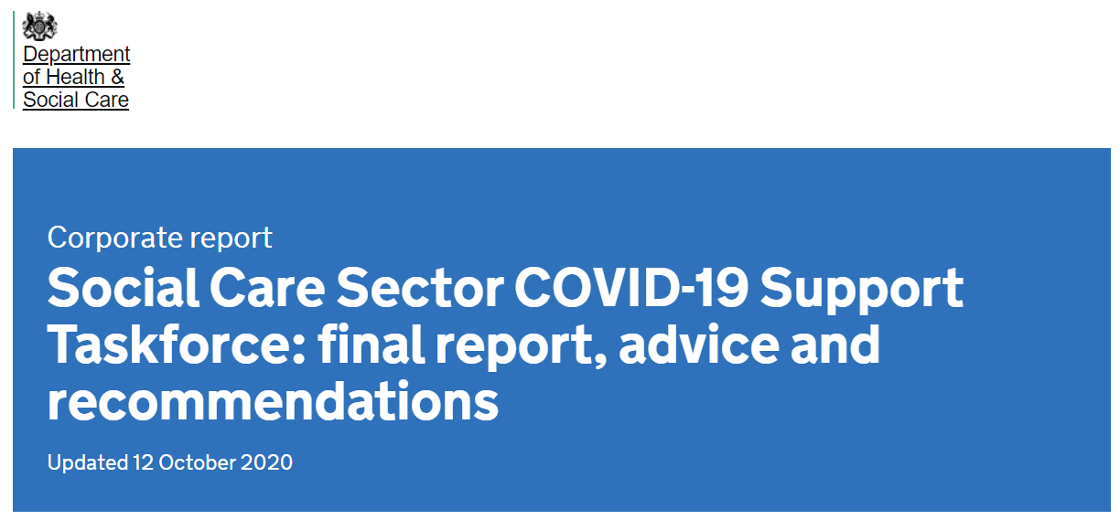
“Expand the choices and control that people have over their own care”

Slide 4
Current Mechanisms for Finding Care
Recommendations from healthcare practitioners
  Problem: unable to recommend specific private companies and no knowledge as to whether these companies are available to help
Google/ Internet Search
  Problem: time-consuming, requires individuals to contact several companies to provide genuine choice, no assurance of quality
Word-of-mouth recommendation
  Problem: relies on individuals having access to a good social network, especially problematic with Covid-19

Slide 5


The Solution
A web platform where users can:
Request Care
based on their specific needs
Receive Offers
from companies who can match those needs
Choose and Connect
With their preferred company based on quality, availability, price and matching of their personal preferences

Slide 6

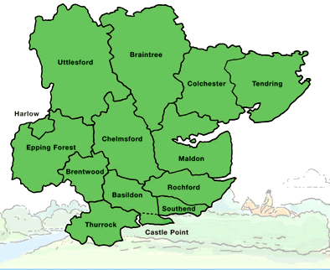


Benefits to Everyone in the Care System
Patients and their Relatives
Local Authorities/CCGs/ICS
Provides choice
Alleviates stress and anxiety
Signposts quality providers
Reduces administrative burden
Digital solution to reduce costs
Hospitals and Community Teams
Care Companies
Reduces ‘bed blocking’ by accelerating discharge
Avoids need for healthcare workers to recommend specific companies
Allows matching of
demand to capacity
Reduces need to spend on marketing

Slide 7

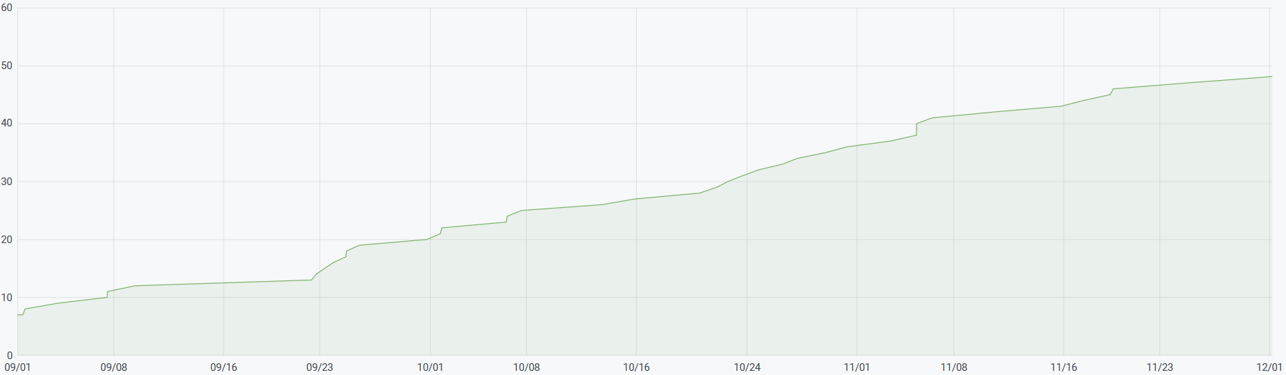







Case Study: Pilot in Essex
42 new users from 01/09/20 to 01/12/20
“Our Local Authority and Voluntary Sector colleagues have welcomed the introduction of CareCompare and seen how it can benefit local people and their families”
Charlotte Williams
Director of Strategy, Mid and South Essex Health Partnership
“CareCompare is a great idea, and having the opportunity to reach out to multiple companies at the same time makes searching for care so much easier”
User in Essex
Some of our Partners in Essex
Notes:
The Mid and South Essex Health and Care Partnership, covering a population of over 1.2 million people, are formally supporting us, at senior executive level and we have a written agreement with them to pilot the site.

Slide 8
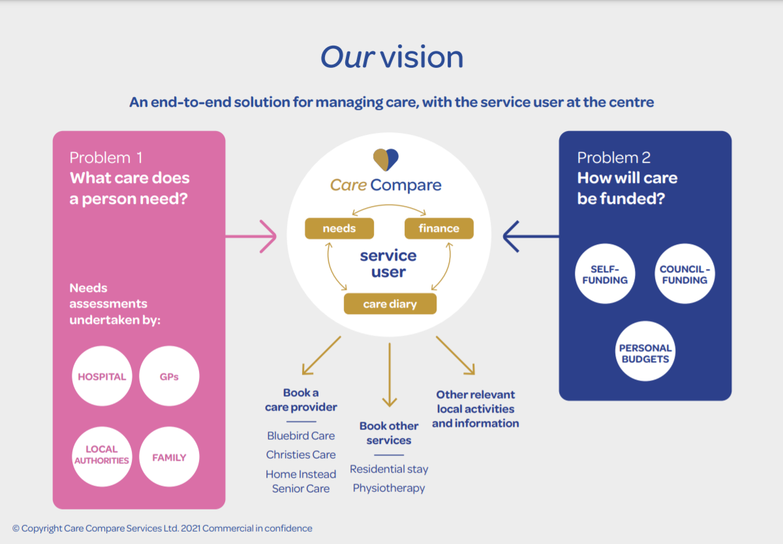

Slide 9
For further information, please contact:
adam@carecompare.net
liban@carecompare.net
Carecompare.net
Notes:
We are seeking £500,000 and would love the opportunity to discuss this further with individual investors.

