Slide 1
Getting more from your Pharmacist
Paula Wilkinson
Chief Pharmacist
Mid Essex CCG
Notes:
<number>

Slide 2

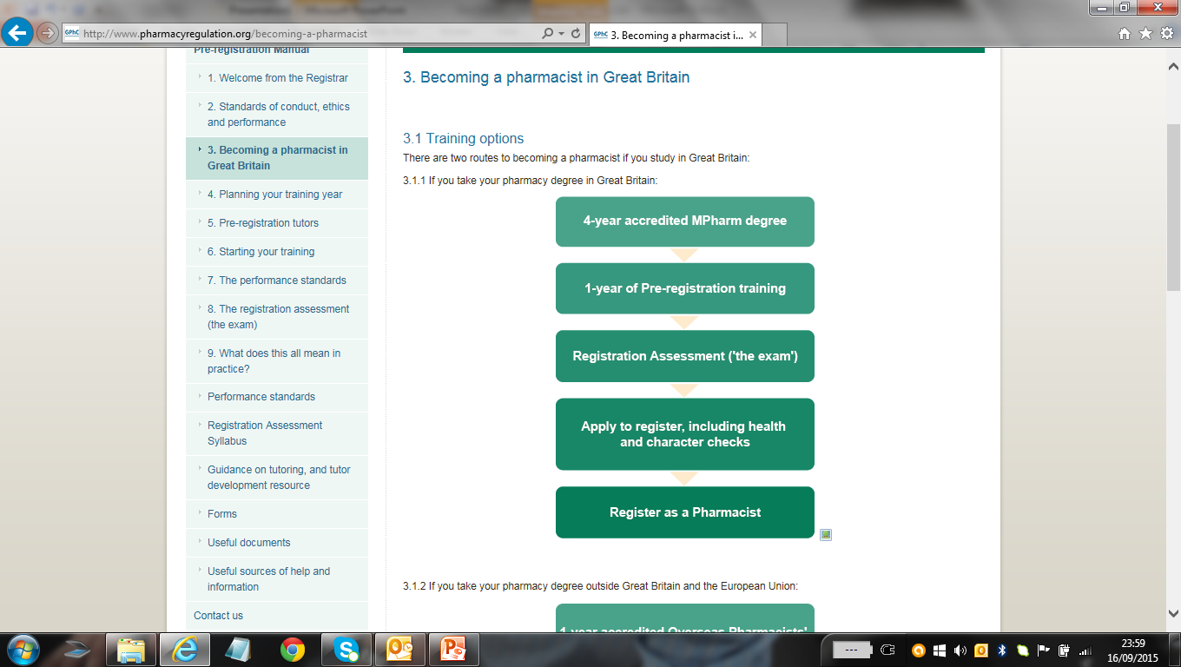

Becoming a pharmacist
https://www.pharmacyregulation.org/

Slide 3

Post-graduate study
Diploma in clinical pharmacy
Masters in clinical pharmacy
Independent prescriber
Advanced Clinical Practitioner
Advanced Practice Framework
Member of Faculty-Royal Pharmaceutical Society
Consultant Pharmacist

Slide 4

Clinical Pharmacist roles
Community
Hospital
General Practice
NHS111/OOH
Primary Care (CCG)
Ambulance
Police Custody
Prison

Slide 5
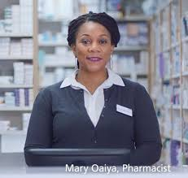

The Community Pharmacist

Slide 6
Community Pharmacy Contract
Essential services
  Dispensing Medicines and Appliances
    Electronic Prescription Service
  Repeat Dispensing
    eRDs
  Disposal of Unwanted Medicines
  Public Health (Promotion of Health Lifestyles)
  Clinical Governance
  Signposting
  Support for Self Care
  Discharge Medicines Service

Slide 7
Community Pharmacy Contract
Advanced Services
  New Medicines Service (NMS)
  Appliance Use Review (AUR)
  Stoma Appliance Customisation (SAC)
  Flu Vaccination
  Community Pharmacy Consultation Service (CPCS)- Minor Ailments and Urgent Medicines-referrals from NHS111 or GPs (GPCPCS)
  Hepatitis C Testing Service
  C-19 LFT Distribution Service
  Pandemic Delivery Service

Slide 8
Enhanced/Locally Commissioned Services
Smoking Cessation- commissioned by Provide through HLP- ECC funded
Sexual Health Services-commissioned by Provide through HLP- ECC funded
Needle Exchange- commissioned by Open Road- ECC funded
Supervised Consumption Methadone/Buprenorphine- commissioned by EPUT (Essex STaRS), ECC funded
NHS Health Checks- commissioned by ACE, ECC funded
Palliative Care CCG funded-MSE wide
COVID Vaccination service
Find nearest pharmacy to patient
https://pcm.prescqipp.info/

Slide 9
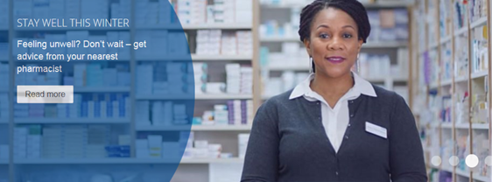


Role of community clinical pharmacist
Support for Self Care
Community Pharmacy Consultation Service
Prevention of illness
  Flu vaccination
  COVID vaccination
LTC monitoring e.g. BP, Asthma
Palliative Care Medicines
Medicines Optimisation
Dispensing Services
New Medicines Service (NMS)
Discharge Medicines Service
Education and Support
Public Health-Healthy Living Pharmacies
Smoking Cessation
Sexual Health
Hep C Testing
Common Ailments
Ongoing adherence support
Promotion Prevention Protection
PATIENT and PUBLIC
Initial supply and support
Early detection
Diagnosis & Treatment
Notes:
<number>

Slide 10
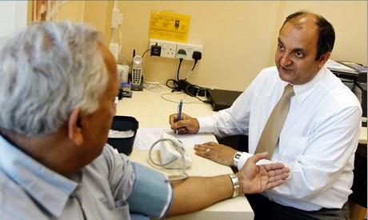

The Practice Pharmacist

Slide 11

General Practice Pharmacists
Primary care pharmacy education pathway- 18 months training
Training core themes
  Fundamentals of general practice
  Prescribing
  Clinical assessment, examination and monitoring
  Consultation and communication skills
  Long-term condition management
  Common ailments management
  Medicines optimisation, multimorbidity and polypharmacy
  Evidence-based medicine and safety
  Leadership and management
https://www.cppe.ac.uk/career/pcpep/pcpep-training-pathway#navTop

Slide 12
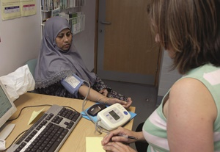
Role of practice clinical pharmacist
Repeat prescriptions/re-authorisation
Dealing with prescription queries
Medication reviews/medicines optimisation
Structured Medication Reviews
Minor ailments
Long-term conditions clinics
Care home patient management
Medication safety- drug alerts
Management of QOF
Notes:
<number>

Slide 13
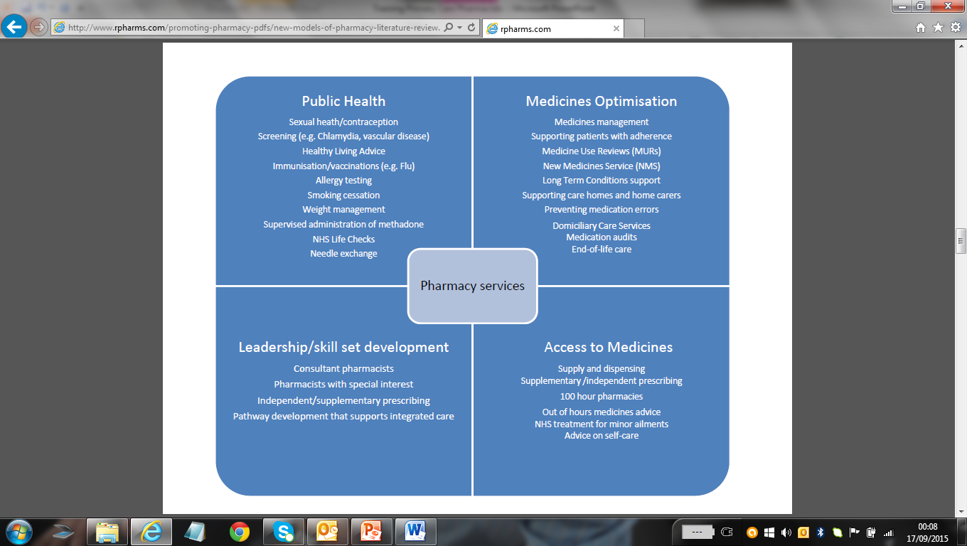

Slide 14
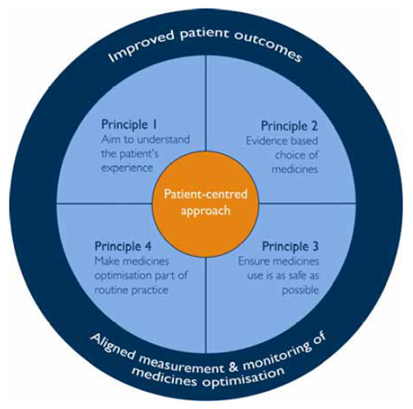
Medicines Optimisation
Medicines Management
High Cost Drugs proformas
Clinical pathways and medication guidelines
Traffic Lights and Grey List
Shared Care
General Prescribing Guidance
Patient Group Directions
Newsletters
Joint Mid Essex Formulary
www.midessexccg.nhs.uk
Improved patient experience
Support patients with LTC to get the most from their medicines
Polypharmacy reviews
Informed choice of medicines
Improved Efficiency
Cost-effective choice of medicines to contain costs within budgets
Generic medicines
National guidelines e.g. NICE CG/TA
Reduce wasted medicines
Partnerships in care-wider primary care team including pharmacy, social and voluntary sector
Patient safety
Review high risk medicines
Reduce inappropriate use of antibiotics
Eclipse Live-reduce risk of adverse events
Improved communications

Slide 15
Get the most from your medicines
Review prescribed medicines with your doctor or pharmacist
Take medicines as prescribed
Don’t order what you don’t need
Don’t order what you are not taking

Slide 16

Get to know your pharmacist
You will be taking good advice!
Paula Wilkinson
Chief Pharmacist
Paula.Wilkinson@nhs.net
01245 398729
07983156583

