Slide 1
Citizens’ Senate meeting no 35
^{22nd} February 2022
Presenter: Trevor Fernandes
Moderator: Godwin Daudu

Slide 2
Extend the Patient Voice
Involvement in programmes, services, policy & research
Access to specialist Health Professionals and speakers
Information and guidance on NHS policy and service change
Support innovation for patient benefit
Training and developmet opportunities

Slide 3
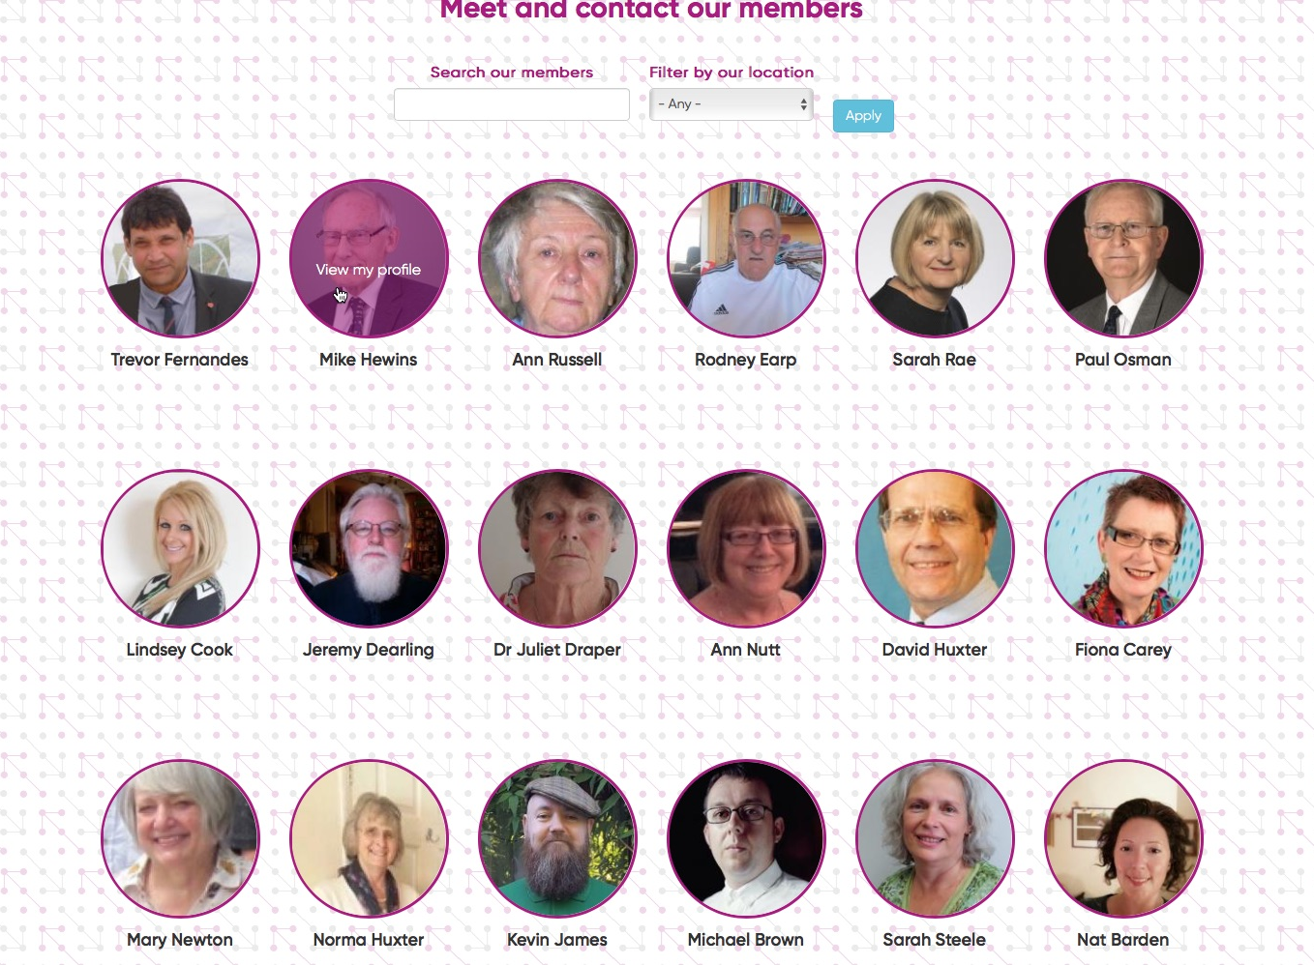
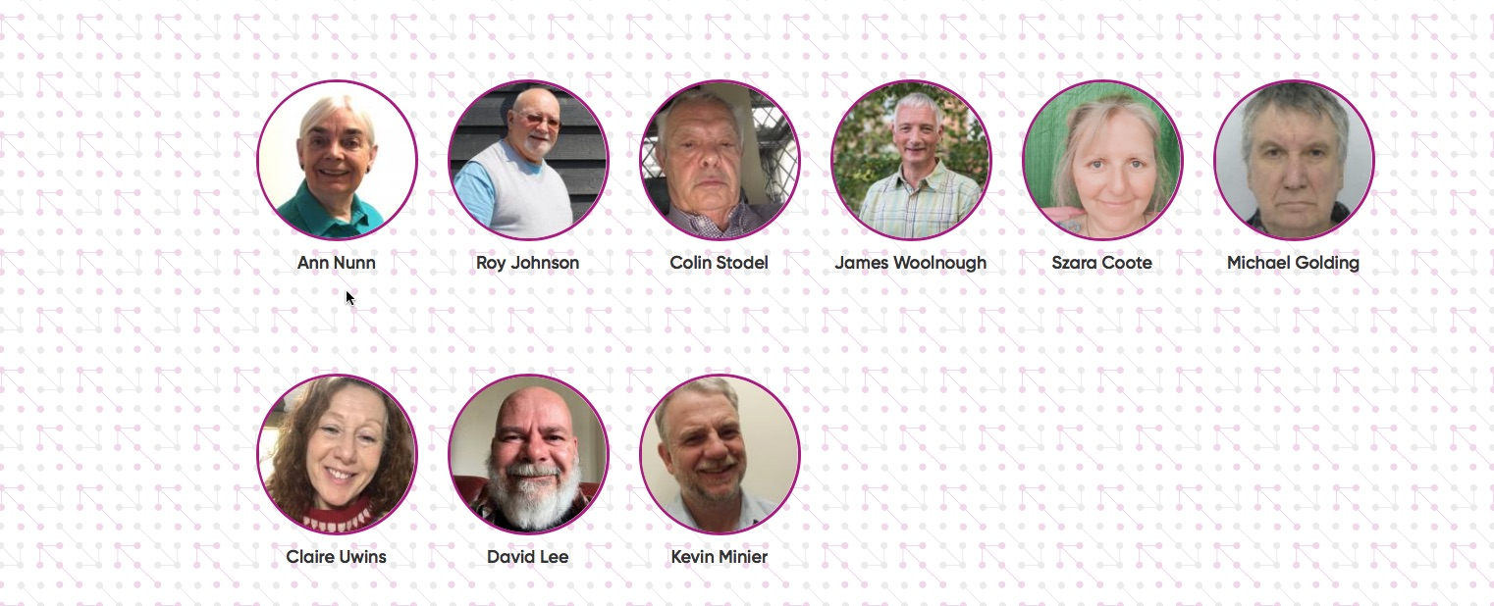
Member Profiles
Name/Profile - about you
Lived experience - e.g. Mental Health
Region - locality where you are most involved
Main Role – e.g. PPG rep, Community Champion etc
Organisations you are involved in, if any
Profile photo

Slide 4
Agenda items
Citizens’ Senate and Eastern AHSN events / activity
24th Nov - Eastern Company meeting - raising awareness
14 Dec - Lunch & share event - meeting new intake of Project Managers and Advisors
27th Jan 2022 - Insight to Impact masterclass
Peer Leader Development Programme - england.pldp@nhs.net

Slide 5
Eastern National Mandate
EAHSN National Portfolio
Nick Clarke, Principal Advisor
Notes:
5

Slide 6
Sharing Experience
Remote Monitoring
Kevin Minier
Notes:
6

Slide 7
Care Compare Update
Dr Adam Ali BMBCh, MA, MRCS
Director & Co-Founder
adam@carecompare.net
liban@carecompare.net
Carecompare.net

Slide 8
Agenda
Welcome & introductions. Welcome to new members and guests
Member Profile details - Why do we need this? - Kevin Minier
Update on Citizens Senate activity.
Eastern AHSN update - portfolio and national mandates - Nick Clarke
CS sharing experiences
Update on Care Compare - Adam Ali
AOB

