Slide 1
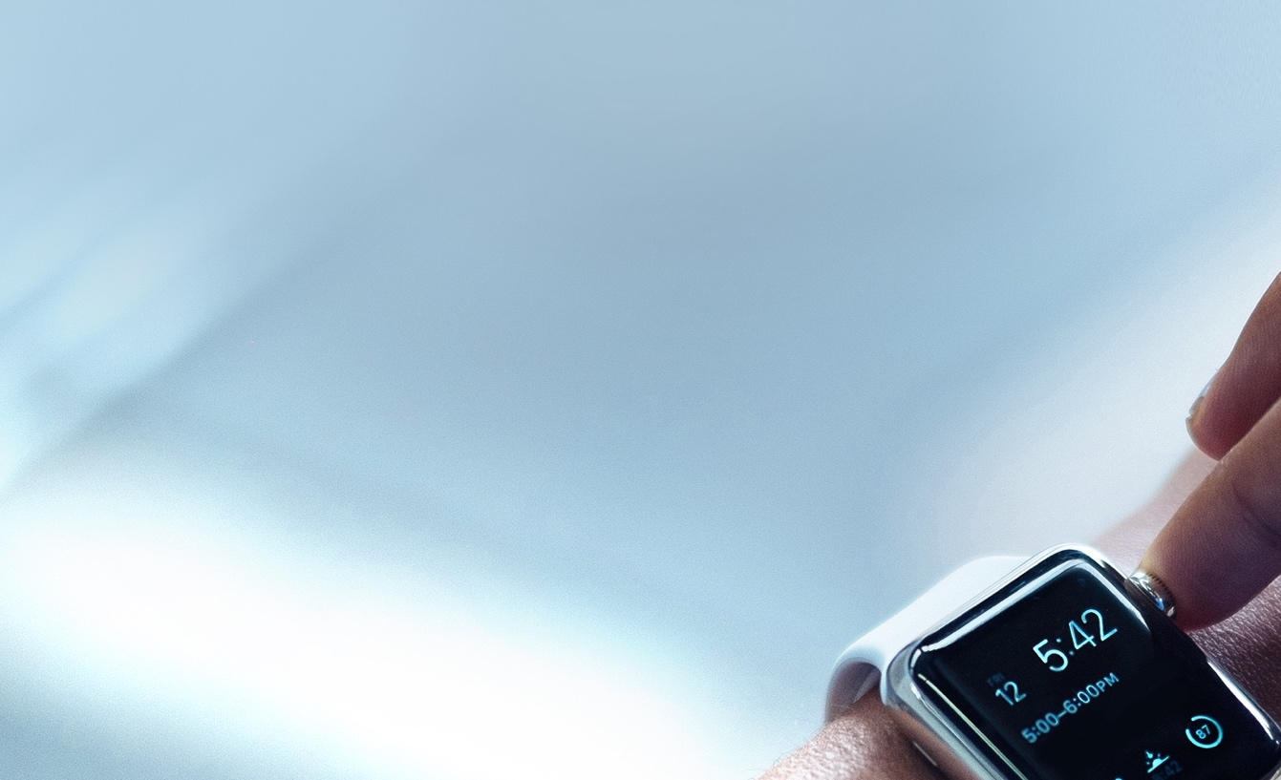

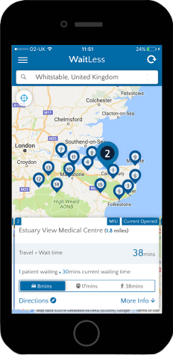


WAITLESS
LIVE WAITING TIME INFORMATION FOR PATIENTS
HOW IT WORKS
WaitLess is an app for patients
  It shows the fastest place to access urgent care treatment for minor conditions
  It combines real-time waiting times with travel time
  It empowers patients, improves experience and takes pressure away from busy A&E departments at peak times
  It’s designed by patients and clinicians
Key Facts:
Benefits:
Found to reduces minor A&E attendances by 11%
Disperses pressure across MIUs and A&E during pressured periods
Deployed quickly (2-4 weeks)
Benefits tracked in real-time

Slide 2
Key Facts
The majority of A&E attendances are from self-presenting patients
A&Es are typically most pressured in the late afternoon / early evenings and at weekends
There is a confusing array of urgent care services
UTCs are often better for patients
Notes:
https://test.e-shrewd.com/WaitlessWidget/componentTest

Slide 3

Patient Stories
https://www.youtube.com/watch?v=ZNDuQ1jBQjw

Slide 4
For More information, please contact:
Alistair Martin,
Chief Commercial Officer,
Transforming Systems email: alistair@transformingsystems.com tel. 07887 716759

