Slide 1
The New Care Models programme: achievements, learnings and next steps
Julia Grace, Deputy Head, Systems Transformation Group, NHS England
26 April 2018
Notes:
Thank you for opportunity to talk to you
Give you information on the NCM programme in particular the vanguards
Give you examples of how care has improved and the impact for patients and systems
How we are transitioning to ICSs
Where you can find further information on best practice from the new care models programme
Run through the presentation and have the opportunity for questions at the end

Slide 2
The health needs of the population are changing…
The changing health needs of the population are putting pressure on the health and social care system in England.
Ageing population
Between 2017 and 2027, there will be 2 million more people aged over 75.
Chronic conditions
The NHS’ predominant task has changed from treating individual episodes of illness, to helping people manage long-term conditions.
New Treatments
The steady expansion of new treatments gives rise to demand for an increasing range of services.

Slide 3
… and the system has not changed enough to meet these needs
Domiciliary Care
Voluntary Sector
Nursing Homes
Hospital
Patient
Mental Health services
NHS 111
Care Homes
Primary care
Service provision is fragmented in multiple different types of organisations
Too often, these services don’t communicate effectively with each other
The totality of patients’ needs are not always understood by those serving them
Care is not always delivered in a person-centred way

Slide 4
There is a shared consensus that integrating care is imperative to meeting these challenges
Integrating services between providers offers us the opportunity to close the three gaps identified in the Five Year Forward View…
Health and wellbeing
Provide more services in the community to promote wellbeing and prevent illness, as well as supporting those living with long-term conditions to confidently self-manage.
Care and quality
Improve the quality of care that patients using multiple services receive, and improve healthcare outcomes.
Funding and efficiency
More proactively manage the health needs of the population, moderating demand for health and services, making the whole system more efficient.

Slide 5
Integrated care means taking a whole populations approach, getting upstream to prevent illness and moderate deterioration
Whole
Population
Urgent Care Needs
Ongoing Care Needs
Highest Needs
Better case management to manage complex needs in the community, for example an extensive care service.
Broader range of services provided in the community, achieved by service providers formally collaborating, for example multidisciplinary teams, social prescribing, patient activation.
Provides a more coherent and effective local network of urgent care, including enhanced primary care and out of hours offer.
Mobilising community assets to address wider determinants of health, and reduce future demand. For example working with employers to promote healthy lifestyles.

Slide 6
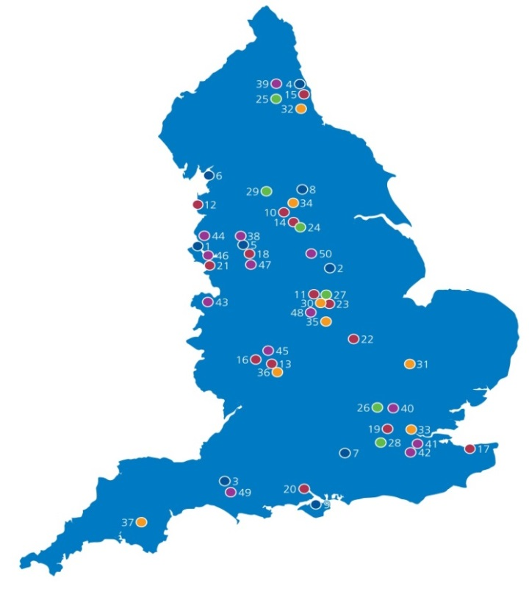
The vanguards role in integrating care
50 vanguards developing new care models as blueprints for our future health and care system
Integrated primary and acute care systems
Multispecialty community providers
Enhanced health in care homes
Acute care collaborations

Slide 7
With the vanguards, we have learnt about the key requirements for developing, delivering, and spreading new care models
Build collaborative system leadership and relationships around a shared vision for the population
Develop a system-wide governance and programme structure to drive the change
Undertake the detailed work to design the care model, the financial model and the business model. This includes clinical and business processes and protocols, team design and job roles
Develop and implement the care model in a way that allows it to adapt and scale
Implement the appropriate commissioning and contracting changes that will support the delivery of the new care model

Slide 8
How vanguards (new care models) have enhanced care for patients
Utilising the power of voluntary and community services
In Tower Hamlets, care co-ordinators in primary care can refer patients to 1500 local voluntary sector organisations that support residents to manage their health and wellbeing
Patients have been supported to engage in arts activities, group learning, gardening, befriending, cookery, healthy eating advice and a range of sports
Integrating care teams across organisational boundaries
In Wakefield, multi-disciplinary teams have formed between care homes & primary care to manage the needs of residents in 27 care homes and 6 supported living facilities
Local analysis showed that ambulance call outs have been reduced by 9% and bed days have reduced by 26% from the 2015/16 baseline
Smoother transitions between care settings
In Sutton, a red bag is used to carry all of care home resident’s medical information and possessions during an admission or attendance to hospital.
The initiative saves time during transfers; allows A&E staff to make more informed decisions and allows for speedier discharge home.

Slide 9
How vanguards have enhanced care for patients
Better case management
Mid-Nottinghamshire: Alliance of 13 health, social care and voluntary sector organisations
Professionals work together in newly formed integrated teams to support patients experiencing complex conditions. Patients are, on average, spending less time in hospital (bed days), generating £20m in recurrent annual savings to the local health and social care system
Specialist care closer to home
Foundation Health Group (Guy’s and St Thomas’ and Dartford and Gravesham NHS Trusts) alliance
Provides specialist services closer to where people live. 300+ ultrasound angiology diagnostic scans provided at Darent Valley Hospital (June 2016-April 2017), saving around 14,000 patient travel miles
Flexible access to specialist support
Morecambe Bay integrated primary and acute care system
Electronic advice and guidance system available across 16 specialities enabled patients to seek specialist support without being referred to secondary care (1,668 referrals avoided)

Slide 10
The patient perspective
Better Local Care (South Hampshire) – Same day access service
Four practices have created a Same Day Access Service (SDAS) which pools the same day primary care workload and workforce for the 4 practices into a single service, operated from a central location at Gosport War Memorial Hospital. 15 nurses and 12 GPs are involved at different times.
Patient background:
Joy, 57, has diabetes and a series of acute issues sometimes needing support without delay
Intervention:
Since the inception of the same-day access service, she’s used the service five times.
She said: “One prescription caused a bad reaction and I was able to phone and get the medication changed on the same day.
“It’s reassuring to know that even if I can’t see my own doctor, I can see a doctor when I need one. It feels like a safety net.

Slide 11
The patient perspective
My Life A Full Life (Isle of Wight) – Crisis Team
A new crisis team to support patients aged over 65 and avoid admission to hospital.
Patient background:
Alice, 79, lived alone and was socially isolated with dementia. Alice had a number of falls which had meant she needed to be admitted to hospital for treatment.
Intervention:
Di Goring, crisis response lead nurse, said: “By working together as a varied team of professionals we can access all the services our patients might need. Initially it was important to find out why Alice was falling – a nurse checked her blood pressure and so on, and following an assessment our occupational therapist, we provided some equipment to minimise Alice’s risk of further falls.
The GP arranged a referral to the memory service and once the crisis was over, we looked at Alice’s social situation and future needs. We asked what she would like to be able to do, and in response a team member from Age UK organised weekly shopping trips.
This new service recognises that patients – even those who are frail and have long-term conditions – don’t always need a hospital admission and can be supported to live well within their own homes.”

Slide 12
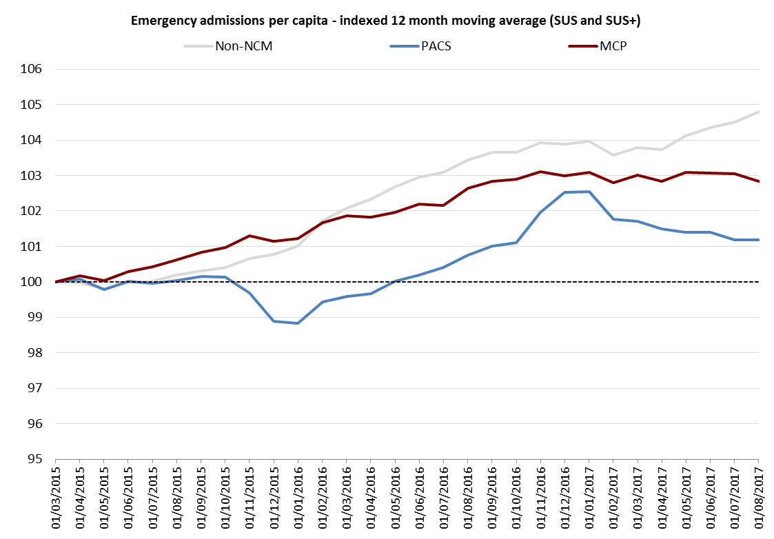
Making the system more effective and efficient
PACS and MCP vanguards have seen slower growth in emergency admissions…
…and care home vanguards reduced admissions
Emergency admissions growth from care home residents²:
Rest of England: +6.7%
EHCH Vanguards: -1.4%
Emergency admissions growth¹:
Rest of England: +4.9%
MCP average: +2.6%
PACS average: +1.2%
For the 12 months to Q2 2017/18, compared to the base-line year 2014/15.
For the 12 months to Q2 2017-18, compared to a baseline period of Q3 2014-15 to Q2 2015-16.

Slide 13
The task now is to spread this learning to systems across England
We launched 44 Sustainability and Transformation Partnerships (STPs) to enhance joint working between NHS commissioners and providers, and local government, in every health and social care system across England.
STPs will provide the opportunity for…
A cultural shift towards systems leadership
Create the right environment and incentives to support the integration of services
Develop sustainable and autonomous systems, that can make the decisions required to improve care in their area within their share of the budget
In time, mature local systems will…
Work together to address systemic challenges
Collaboratively develop a care model that more proactively manages need and gets upstream to prevent illness
Makes the necessary decisions to improve services in their area, within their share of the budget

Slide 14
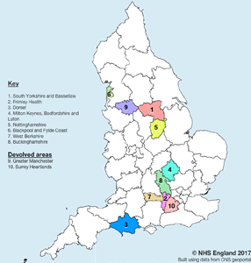
Some areas of the country are moving to population based models of care faster – Integrated Care Systems (ICSs)
Taking collective responsibility for resources and population health, providing joined up, better coordinated care
Making faster progress on national priorities:
taking strain off A&E
making it easier to see a GP
improving access to cancer and mental health services
Enabling more control over available funding, supporting transformation
Being accountable for improving health and wellbeing of their populations
Using data and public engagement to understand the real needs of their population
9+ million people
We will add to the cohort of ICSs as more STPs, or parts of STPs,
become ready to take on enhanced accountability

Slide 15
Emergent findings suggest there are three key ‘building blocks’ for delivering integrated care systems…
National/Regional/Sub-Regional
Integrated care system
Integrated provider groups
Primary care networks

Slide 16
How ICSs will enhance care for patients
Urgent and emergency care
Improve access to urgent treatment centres
Greater co-ordination with social care to improve discharge
Primary Care
Form primary care networks that share workforce, infrastructure and pool responsibility for urgent care and extended access
Increase use of integrated, multidisciplinary teams in primary care
Mental Health
Improve access to psychological therapies, including for children and young people
Develop 24/7 community crisis response and home treatment teams
Increase physical health checks for people with severe mental illness
Improve early diagnosis with new screening technologies and programmes
Develop specialist perinatal mental health provision
Mental Health
Cancer
Increasing survival rates, expanding screening and faster treatment
Improving patient experience and quality-of-life following cancer diagnosis and treatment

Slide 17
The model is starting to bear fruit… In Frimley, activity is falling
Referrals
Relative percentage changes 2015-16 to 2017-18 YTD
Emergency Admissions
Relative percentage changes 2015-16 to 2017-18 YTD

Slide 18
…with support from national workstreams, co-led by integrated care systems
Accelerating service improvement in priority clinical areas
Improvements in clinical priority areas
Cancer
Urgent and Emergency Care
Clinical improvements in priority
Primary Care
Mental Health
System finance reform
Shared system control totals
Payment models
Capital and transformation funding
System-wide efficiencies
Leadership and international learning
Leadership development
Governance
Future regulatory and commissioning models
Commissioning
Streamlining oversight
Population health management
Public health
Data analytics and external partnerships
Care model design
Communicating and campaigning for change
Local
Regional
National

Slide 19
Access to Learning Materials
New Care Models case study library: https://future.nhs.uk/connect.ti/Home/view?objectId=437572#437572
And the Kings fund report on the learning from the NMC:
https://www.kingsfund.org.uk/publications/mental-health-new-care-models
Communities of Practice – Vanguards & ICS’s
Spread through the new ICS’s

Slide 20
For further information…
More details can be found on the NHS England website:
www.england.nhs.uk/vanguards
For more information on STP/ICSs:
www.england.nhs.uk/systemchange
You can contact me:
Julia.Grace@nhs.net
Or join the conversation on Twitter using the hashtag: #futureNHS

