Slide 1
Atrial Fibrillation Programme Update
Dr Amanda Buttery
Atrial Fibrillation Programme Manager
amanda.buttery@eahsn.org
Citizen’s Senate 23.4.2019

Slide 2

What is Atrial Fibrillation?
A heart condition that causes an irregular and often abnormally fast heart rate
Symptoms:
  dizziness, shortness of breath, tiredness. Aware of heart palpitations
  many have no symptoms at all.
Risk factors:
  age, high blood pressure, alcohol, obesity, diabetes and other conditions.
It increases the risk of having a stroke

Slide 3

Atrial fibrillation can be treated
There are medications that help
Warfarin and other heart medications
(oral anti-coagulants)
Opportunities to help more people
  30% of people with AF don’t know they have it (underdiagnosis)
  Over half of people are not getting the right medicines at the right dose

Slide 4
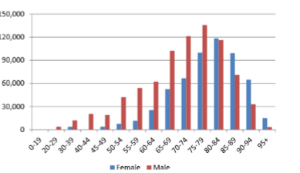
AF is more common at older ages
Over 65’s = 5.5% prevalence of AF
Over 85’s = 15% prevalence of AF
Higher among men

Slide 5
The AHSN Approach: Detect, Protect and Perfect

Slide 6
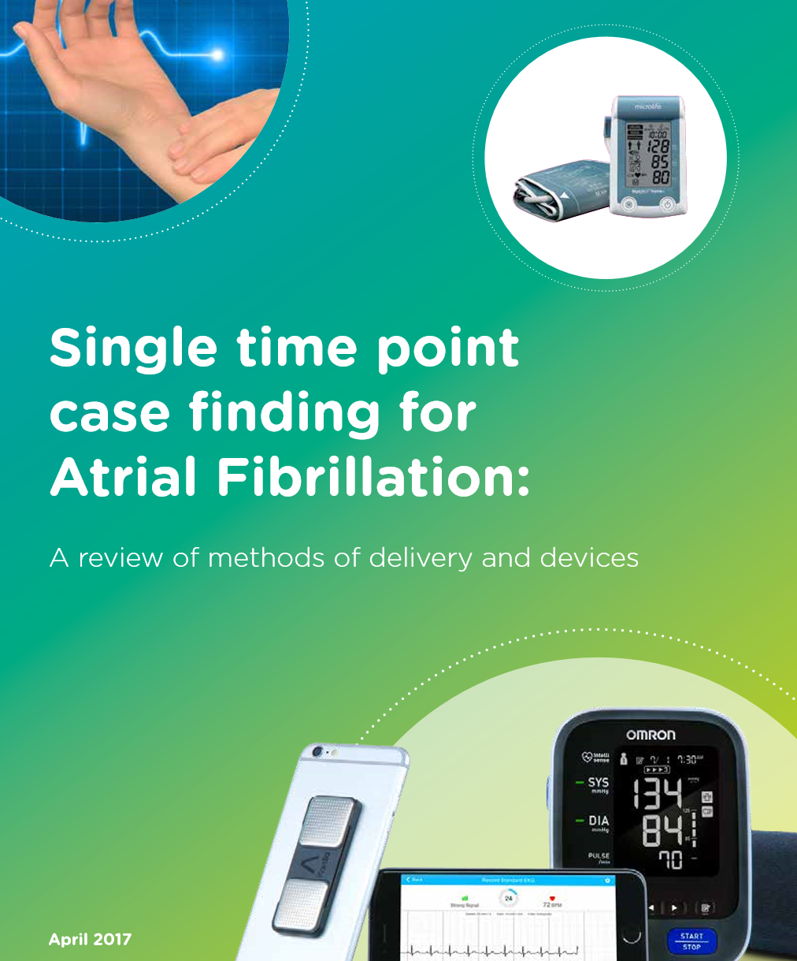
Devices to detect AF
Many new and emerging devices
  35 to date, and counting!
AHSN overview of AF detection devices
NICE overview currently underway
http://bit.ly/af-device-review

Slide 7
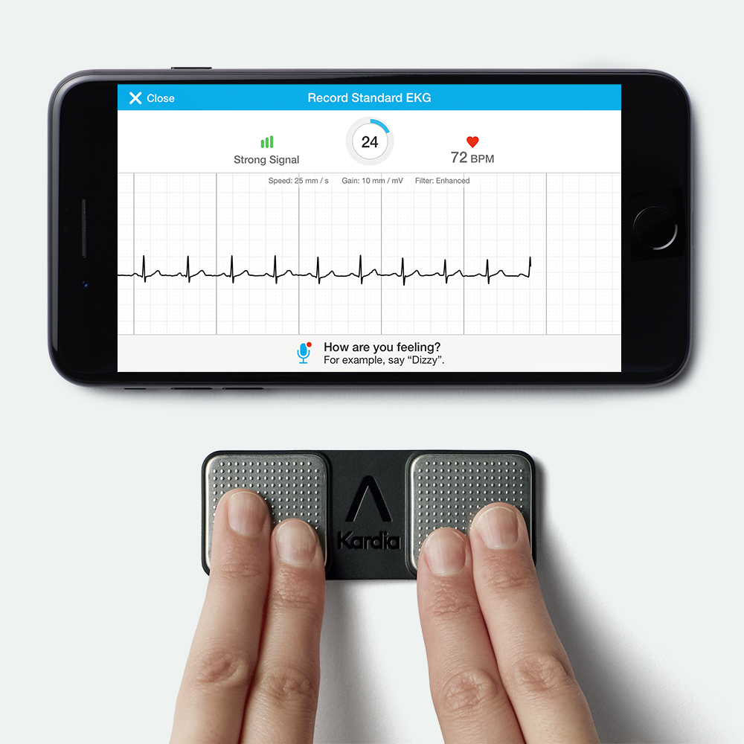

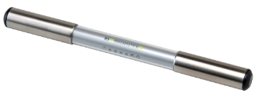
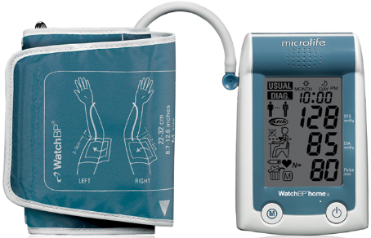
The 5 devices in the national roll-out
AliveCor Kardia Mobile
RhythmPad
MyDiagnostick signals AF by using a red or green led light
imPulse thumbs on the sensors. Signal is transmitted using Bluetooth to a Smart-phone or Table computer
WatchBP

Slide 8
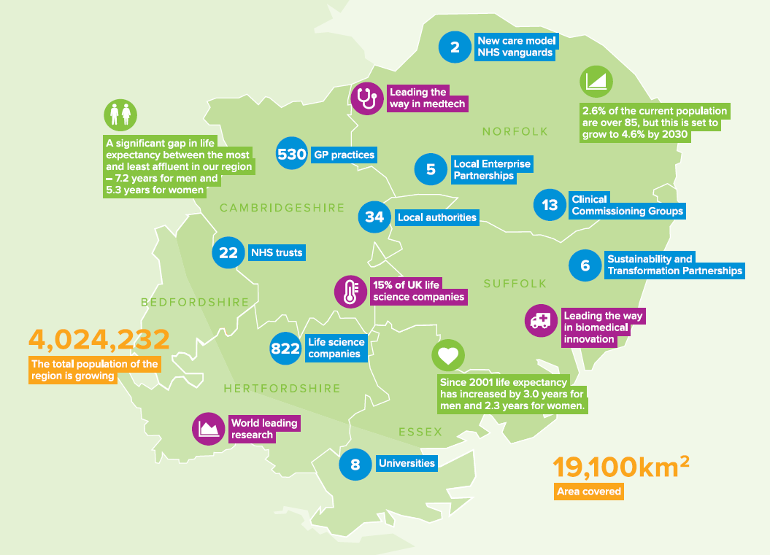
Our region
We cover six STPs - Cambridgeshire & Peterborough, Norfolk & Waveney, Suffolk & North East Essex, Hertfordshire & West Essex, Mid & South Essex (Mid only) and the Eastern border of Bedfordshire
> 4 million people
46 NHS organisations
34 local authorities
13 Clinical Commissioning Groups (CCGs)
Eastern Collaboration for Leadership in Applied Health Research and Care (CLAHRC) and Clinical Research Network (CRN)

Slide 9
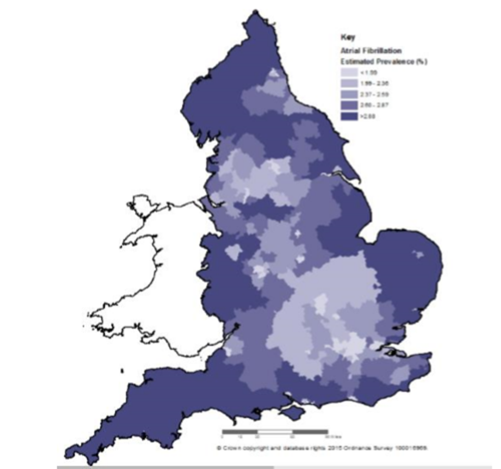

Which CCG has the highest estimated AF prevalence?
a) South Norfolk CCG
b) West Suffolk CCG
c) North East Essex CCG
d) Cambridgeshire and Peterborough CCG
e) North Norfolk CCG
Notes:
Across England AF prevalence varies 1.0 - 3.9%
Eastern AHSN
Estimate AF prevalence (2017) = 2.55%
North Norfolk CCG
Estimated 3.9% = 1,751 undiagnosed cases

Slide 10

Mobile ECG device roll-out in Eastern region
Key milestones:
  Expressions of Interest closed 21 Feb 2018
  All CCGs involved and ≃ 600 Kardia devices dispatched
  Raising Awareness – many regions and many events!
  Suffolk - ParkRun, Bury St Edmunds Beer Festival, Women’s Institute
  Hospitals - Addenbrooke’s, West Suffolk, Queen Elizabeth Hospital
  East Anglian Press coverage and Cambridge TV
Training and Clinician Upskilling
  GP and Pharmacist Upskilling Event – Newmarket 2018
  Supported Arrythmia Alliance Cardiac Update meeting in Cambridge – 2018
    Coming soon - 12 June 2019 Anglia Ruskin University http://www.arrhythmiaalliance.org.uk/

Slide 11
Atrial Fibrillation: Programme aims by March 2020
  To achieve 85% detected prevalence
    - additional 134,000 people with AF detected
  To achieve 84% of people with AF and CHA₂DS₂VASc score ≥ 2 currently treated with anticoagulation - ACHIEVED!
    - Now aim to see 90% of CCGs achieve 84% by 2020

Slide 12
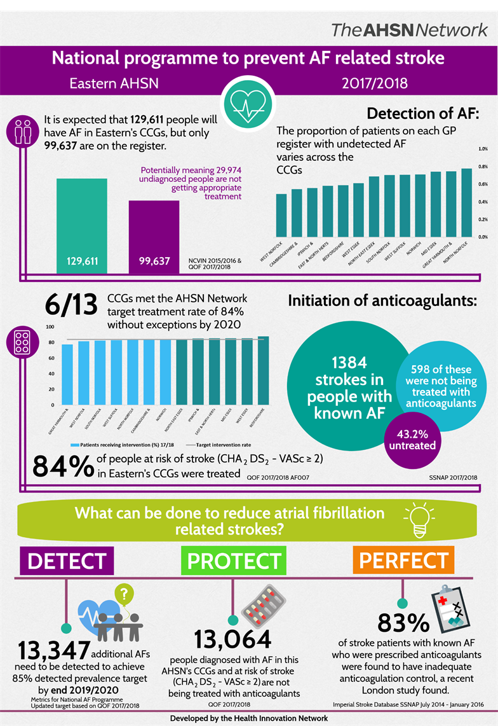

Slide 13
Which CCG has the highest proportion of patients with AF on anticoagulation?
a) Norwich CCG
b) Bedfordshire CCG
c) West Essex CCG
d) Cambridgeshire and Peterborough CCG
e) West Norfolk CCG

Slide 14
Next steps : Virtual clinics programme
Great Yarmouth and Waveney CCG
  Selected as one of the 21 CCGs for the national demonstrator programme
  Reviewing patients on AF register not on anticoagulation medicines
  Hear all about this model on the round table!
Lee Valley GP Federation
  Support local innovative model
  Promote systematic audit in practices (GRASP-AF tool)
  Optimising reviews with clinical pharmacists in GP practices

Slide 15
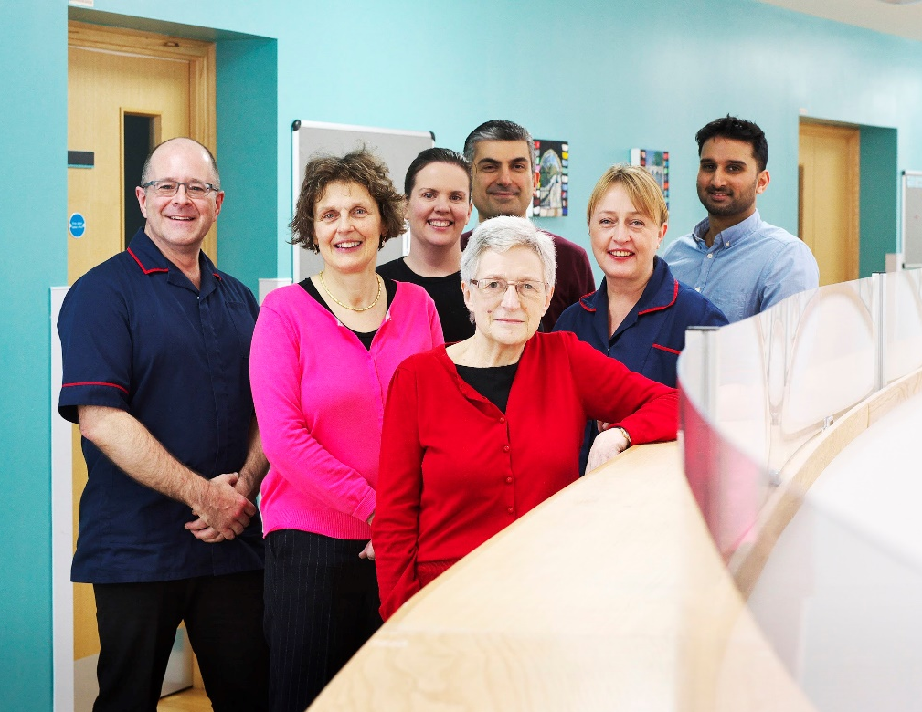
Screening and Optimising Stroke Prevention in Atrial Fibrillation (SOS-AF) project
SOS-AF at Addenbrookes
Novel multidisciplinary stroke prevention service
2 stroke consultants, 1 registrar doctor and 2 specialist nurses
Set up in 2017 aims to:
  increase the number of people provided with effective anticoagulation medicines
  improve patient care between primary and secondary care services.
Provides:
  in-hospital AF screening
  initiates anticoagulation
  specialist assessment and advice to primary and secondary care
  includes an outpatient service.
    Funding: AHSN Network’s partnership with the Alliance Anticoagulation Foundation for stroke prevention in AF.

Slide 16
Regional Resources
Notes:
improvement@eahsn.org

Slide 17
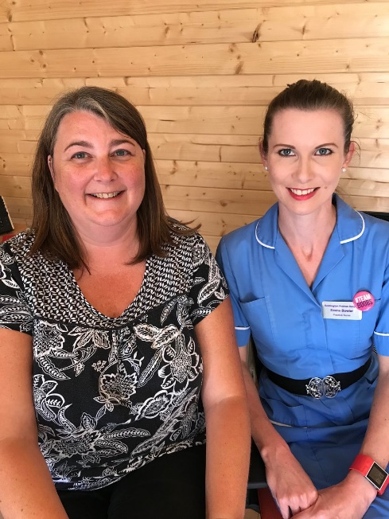

Listen to the Podcast
Rollout in 5 practices in Bedfordshire
Used practice tablets
Embedded use in multiple practices (including nurse-led long-term condition clinics)
Became business as usual in just 4 weeks!
http://bit.ly/2tKHBMw

Slide 18
Have you met Jack yet?
The video shows Jack and his story of starting anticoagulant medicines
Could the Citizen’s Senate please promote this?
View it on the Eastern AHSN website

Slide 19
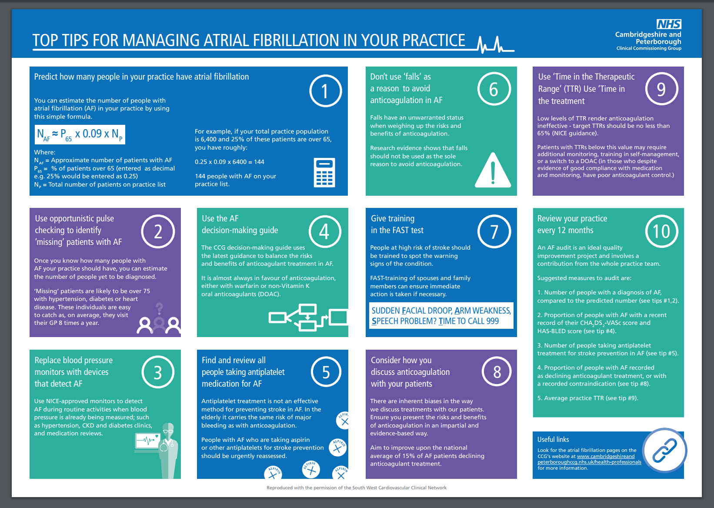
https://www.cambridgeshireandpeterboroughccg.nhs.uk/health-professionals/patient-pathways/atrial-fibrillation/clinical-resources/

Slide 20









Atrial Fibrillation: A priority for many organisations

Slide 21
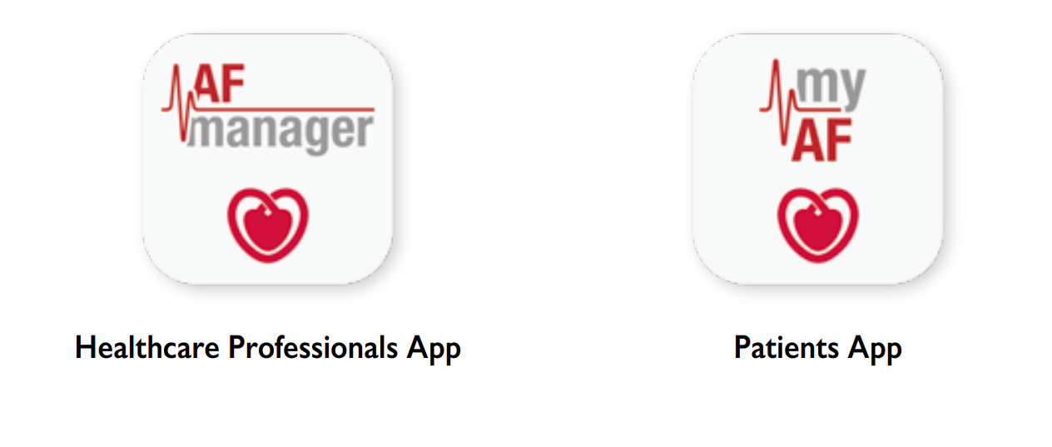
European Society of Cardiology Apps
Download from Google Play, Amazon and Apple App Stores
https://www.escardio.org/Guidelines/Clinical-Practice-Guidelines/Guidelines-derivative-products/Get-the-essential-messages-and-the-educational-slide-sets

Slide 22
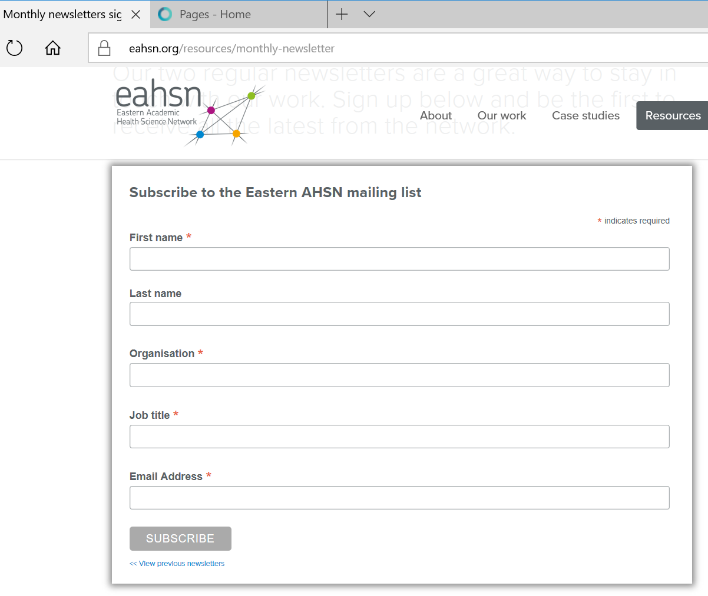
Join our Newsletter for updates
Visit our website www.eahsn.org
Please sign up to our Monthly Newsletter
https://www.eahsn.org/resources/monthly-newsletter/

Slide 23
Thank you

